Slide 1
Cloud Computing
By Shahzad Abbas

Slide 2
Today’s Agendas
Introduction to Cloud Services
Different Cloud Service providers
Introduction to Microsoft Azure
Cloud Computing related terms and its definitions
Azure Account Creation
Azure Portal Dashboard Overview

Slide 3

Introduction to Cloud Services
Cloud computing allows individuals and organizations to access computing resources over the internet.
Resources include servers, storage, databases, software, and more.
Pay-as-you-go model eliminates the need for physical hardware ownership.
Remote data centers managed by cloud service providers are utilized.

Slide 4
Motivation Behind Cloud Computing
Cost Efficiency:
Eliminates the need for costly data centers and hardware.
Allows pay-as-you-go pricing, reducing capital expenses.
Scalability:
Easily scales resources up or down to handle varying workloads.
Enables quick adaptation to changing business requirements.
Accessibility:
Can be accessed from anywhere with an internet connection.
Facilitates remote work and collaboration.
Reliability:
Offers high uptime and redundancy compared to on-premises solutions.
Reduces the risk of service disruptions.

Slide 5
Motivation Behind Cloud Computing
Security:
Includes robust security measures provided by leading cloud providers.
Often surpasses the security capabilities of smaller organizations.
Global Reach:
Utilizes data centers worldwide for low-latency access.
Expands businesses' ability to serve a global customer base.
Innovation:
Provides access to a wide range of advanced tools and services.
Accelerates innovation through integration of AI, machine learning, and more.

Slide 6
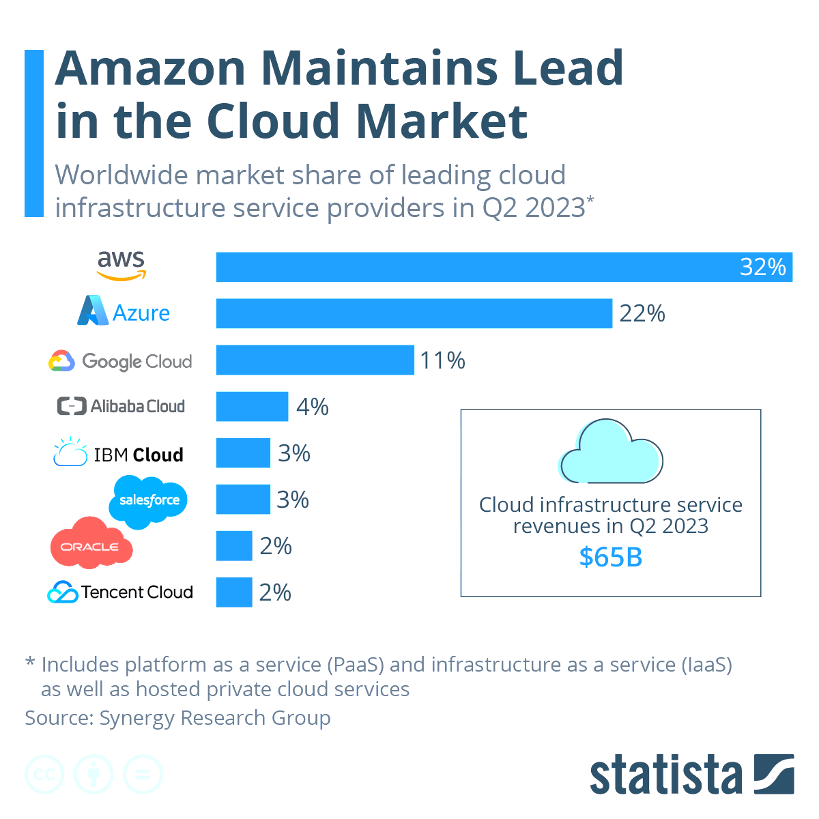
Different Cloud Service Provider

Slide 7
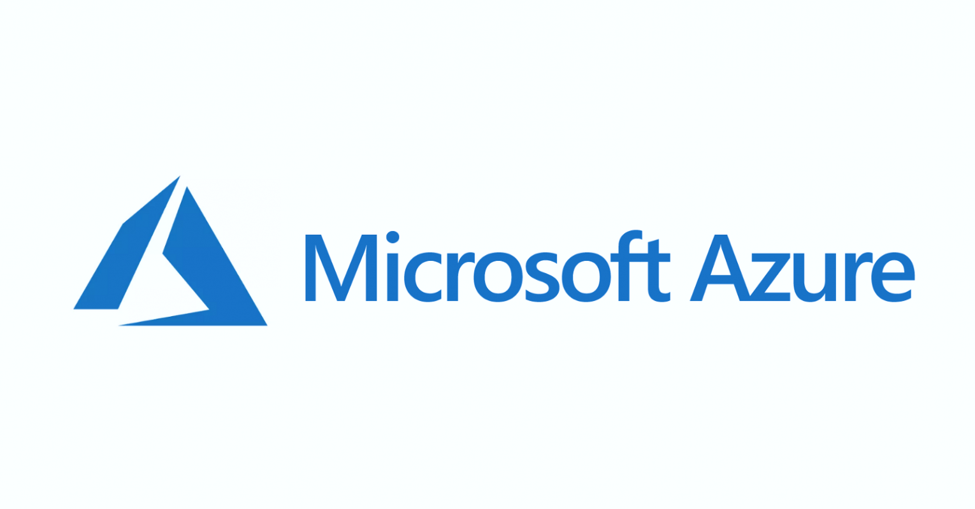
Microsoft Azure
Microsoft Azure, commonly referred to as Azure, is a powerful cloud computing platform and a suite of services offered by Microsoft.
Azure provides a wide range of cloud-based resources, including computing power, storage, databases, networking, analytics, artificial intelligence, and more, that enable individuals and organizations to build, deploy, and manage applications and services efficiently and at scale.

Slide 8
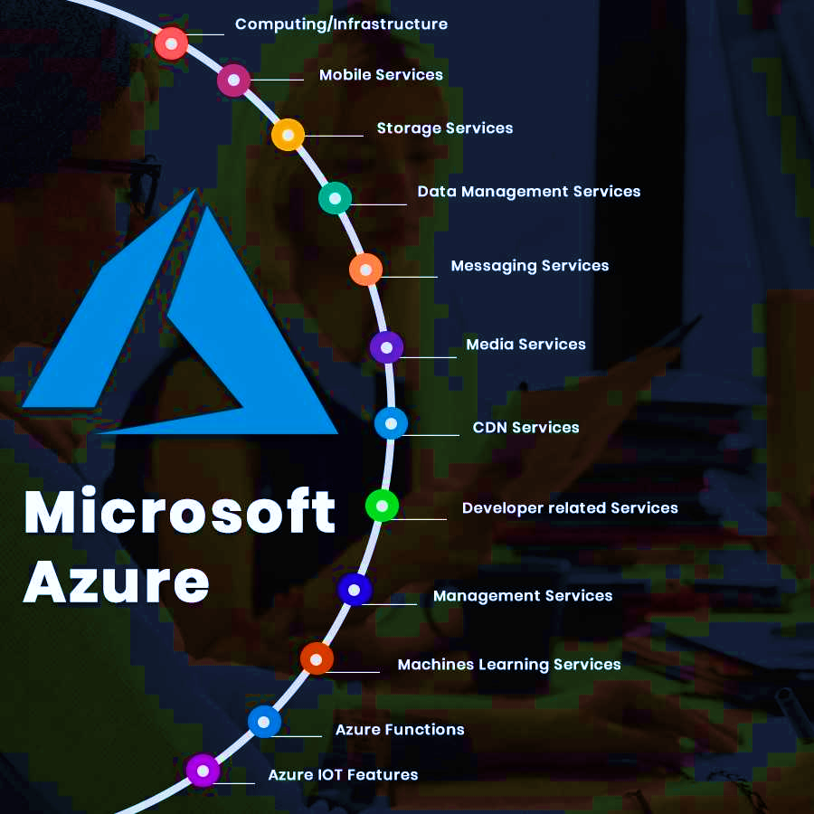

Slide 9
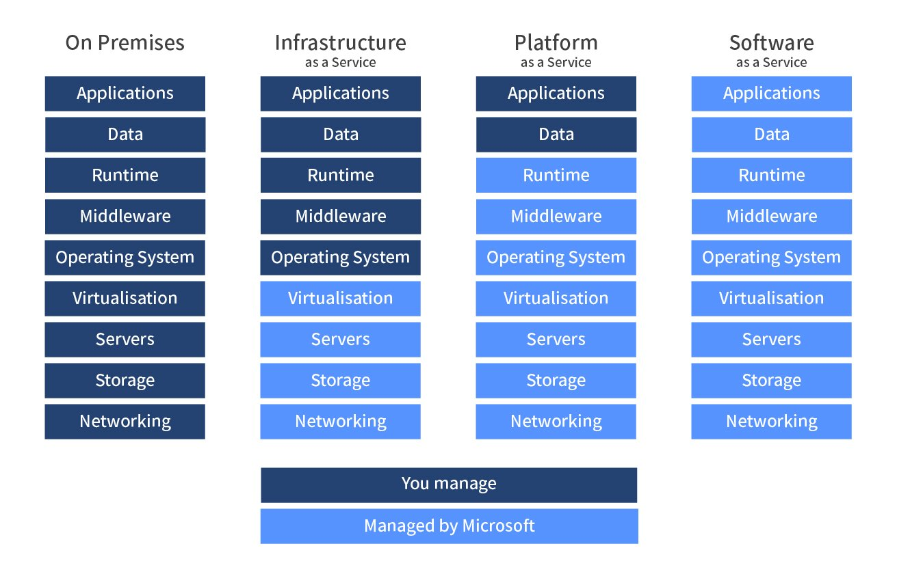
Infrastructure as a Service (IaaS)
IaaS provides virtualized infrastructure resources.
Users can provision and manage resources like VMs, storage, and networking.
Azure IaaS Solutions:
Azure Virtual Machines (VMs):
Create and manage virtualized Windows or Linux servers.
Customize VMs to meet specific application requirements.
Azure Storage:
Scalable and secure cloud storage solutions.
Blob, file, table, and queue storage options.
Azure Networking:
Virtual networks, load balancers, and VPN gateways.
Securely connect resources and control traffic.

Slide 10
Platform as a Service (PaaS)
PaaS offers a development platform and environment.
Developers can create, deploy, and manage apps without infrastructure concerns.
Azure PaaS Example: Azure App Service
Azure App Service:
Fully managed platform for building, deploying, and scaling web apps.
Supports various programming languages and frameworks.
Auto-scaling and continuous deployment for efficient development.

Slide 11
Software as a Service (SaaS)
SaaS delivers software applications over the internet via subscriptions.
Eliminates the need for local installations and maintenance.
Azure SaaS Offerings:
Office 365:
Suite of productivity apps like Word, Excel, and Outlook.
Collaboration tools like Teams and SharePoint.
Dynamics 365:
Comprehensive suite of business applications.
Includes CRM and ERP solutions for various industries.

Slide 12
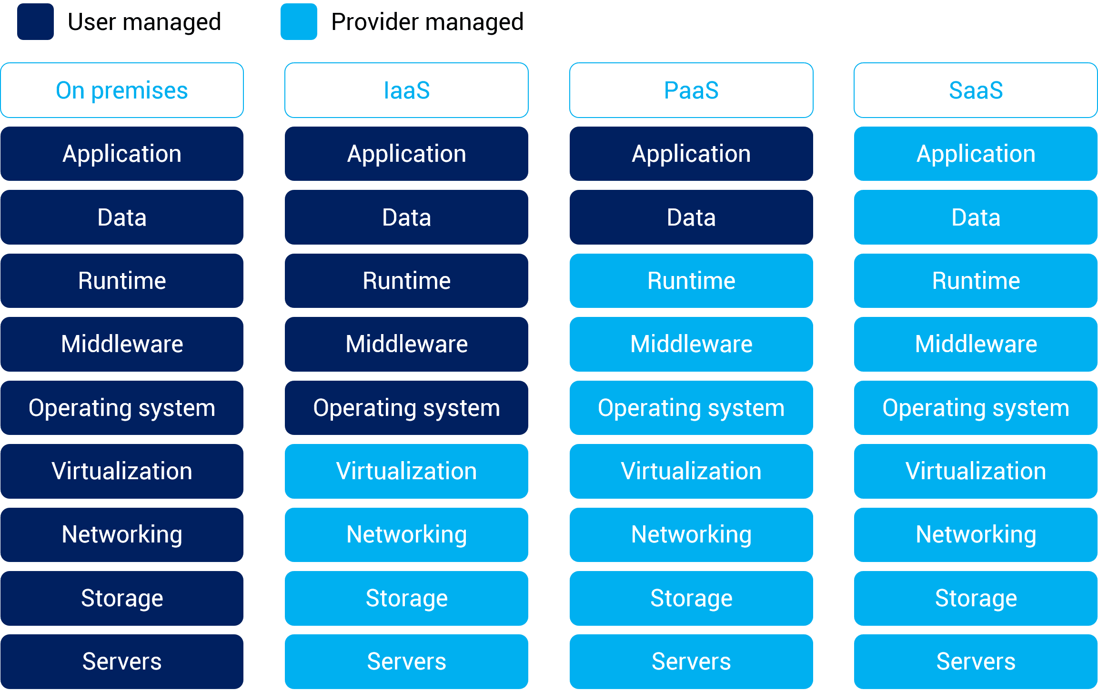
Azure Model Architecture

Slide 13
Key aspects of Microsoft Azure
Infrastructure and Services: Azure offers Infrastructure as a Service (IaaS), Platform as a Service (PaaS), and Software as a Service (SaaS) solutions, giving users the flexibility to choose the level of control they need.
Scalability: Azure's cloud resources can be easily scaled up or down based on demand, making it suitable for projects of all sizes.
Integration: Azure seamlessly integrates with other Microsoft products, such as Windows Server, Active Directory, and Office 365, as well as third-party tools and services.
Security and Compliance: Microsoft Azure offers robust security features, compliance certifications, and tools to help users secure their data and meet regulatory requirements.
Development Tools: Azure provides a range of development tools and frameworks, including Visual Studio and Azure DevOps, to streamline application development and deployment.
AI and Data Services: Azure offers various services for artificial intelligence, machine learning, data analytics, and Internet of Things (IoT) to empower businesses with data-driven insights.

Slide 14

Happy Learning!

